Slide 1


Deep Learning in Age - Invariant
Face Recognition
Advisors
Nguyen Quoc Trung
Thesis Defense
Members
Le Quang Minh
Ton Nu Quyen Mi
Nguyen Lam Nguyen

Slide 2
01
Introduction
02
Context
Contents
03
Methods
04
Results & Demo
05
Conclusion

Slide 3
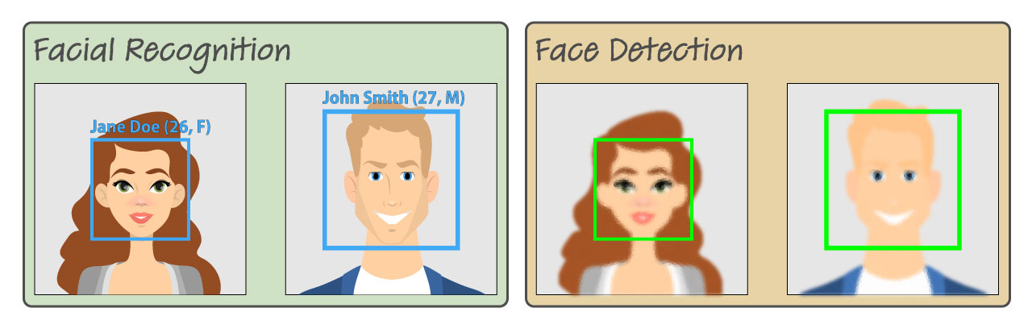
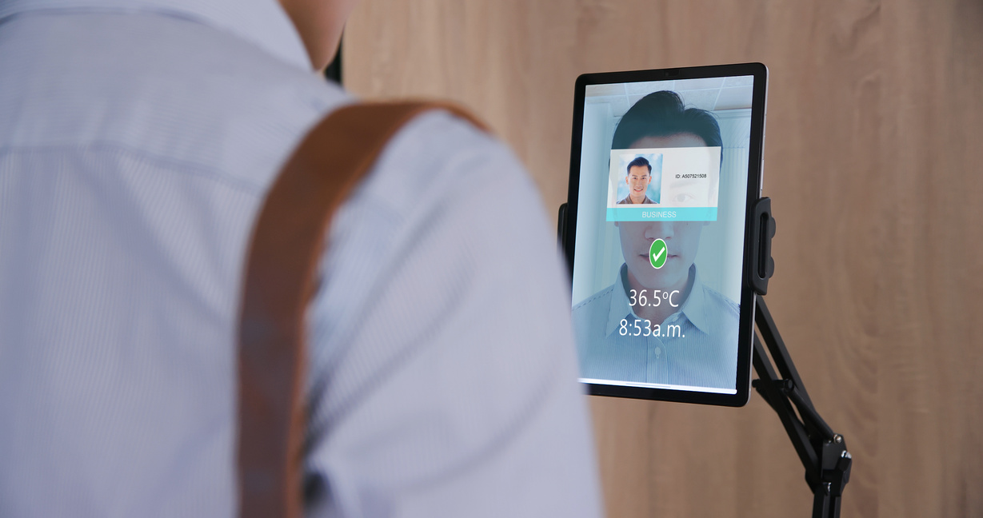
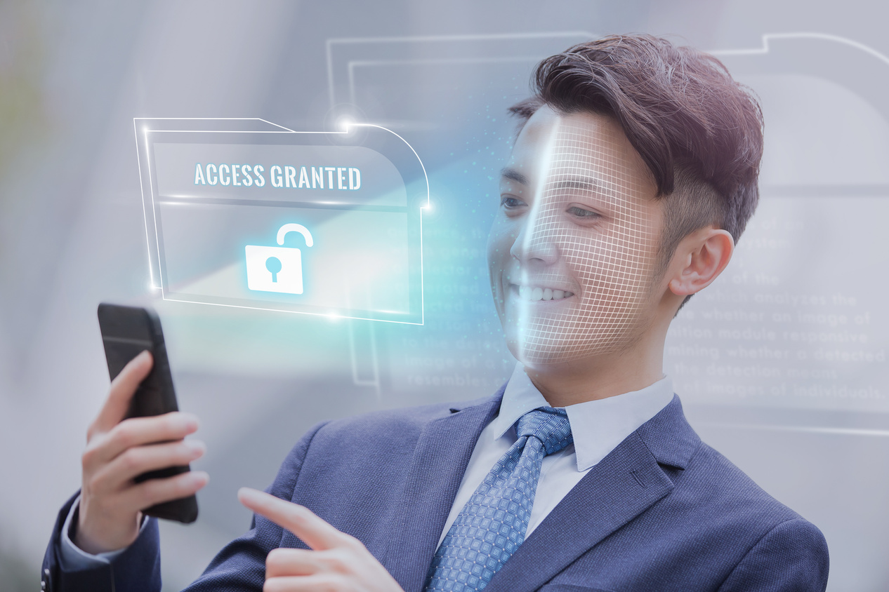
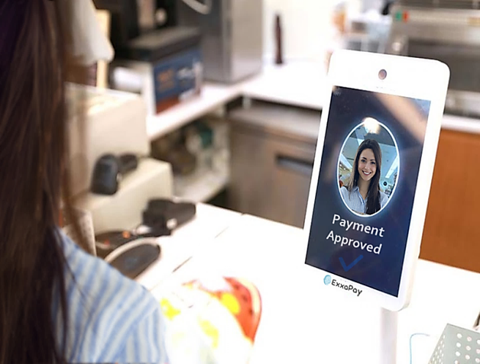

Introduction
01

Slide 4

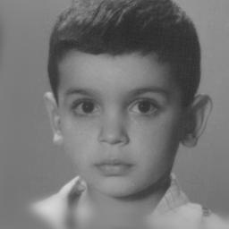
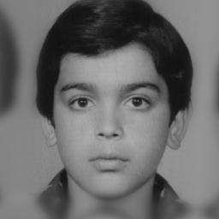
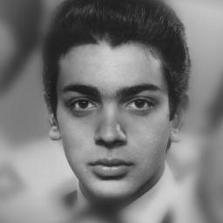
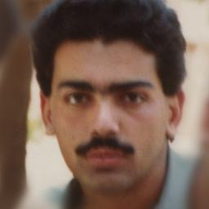
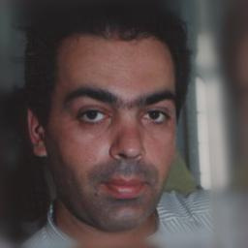

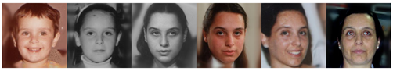
01
Age - Invariant Face Recognition

Slide 5

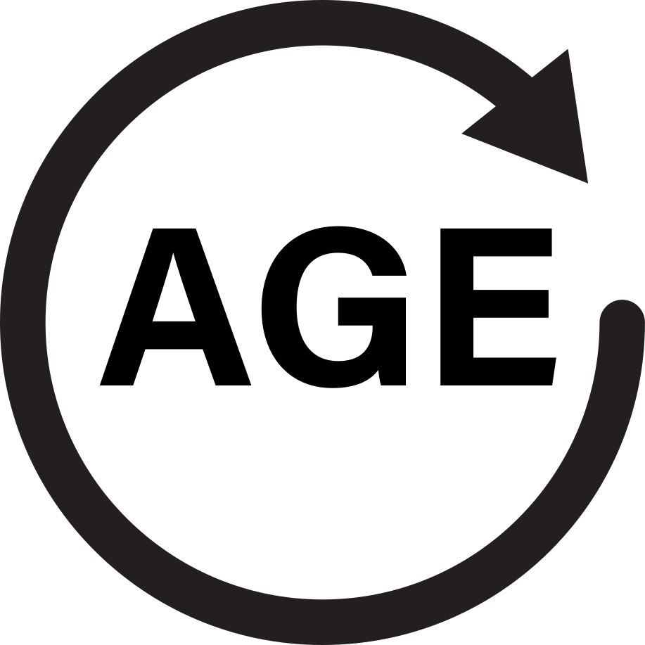


02
Context
effect of
learn about
challenge for
COMPUTER VISION
TIME
(AGING)
SELF-SUPERVISED LEARNING

Slide 6

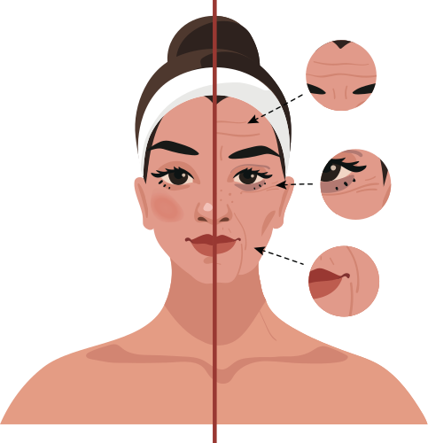
02
Proposed Solution
Propose an age - independent, machine - based face recognition model that learns the subspaces of the age-dependent changes of faces independently for recognition. Then apply Self-Supervised Learning.

Slide 7
Dataset overview
Workflow
03. Approach
Data processing
Methods

Slide 8
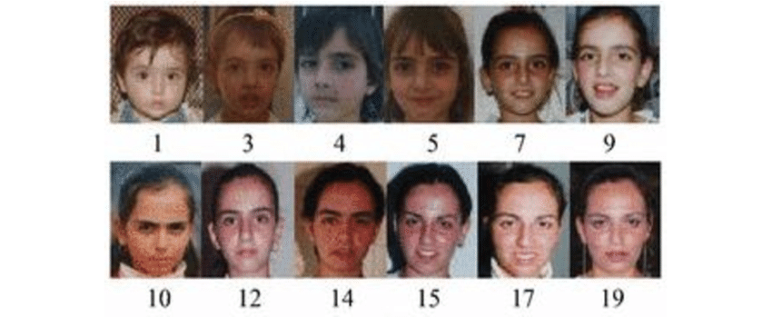
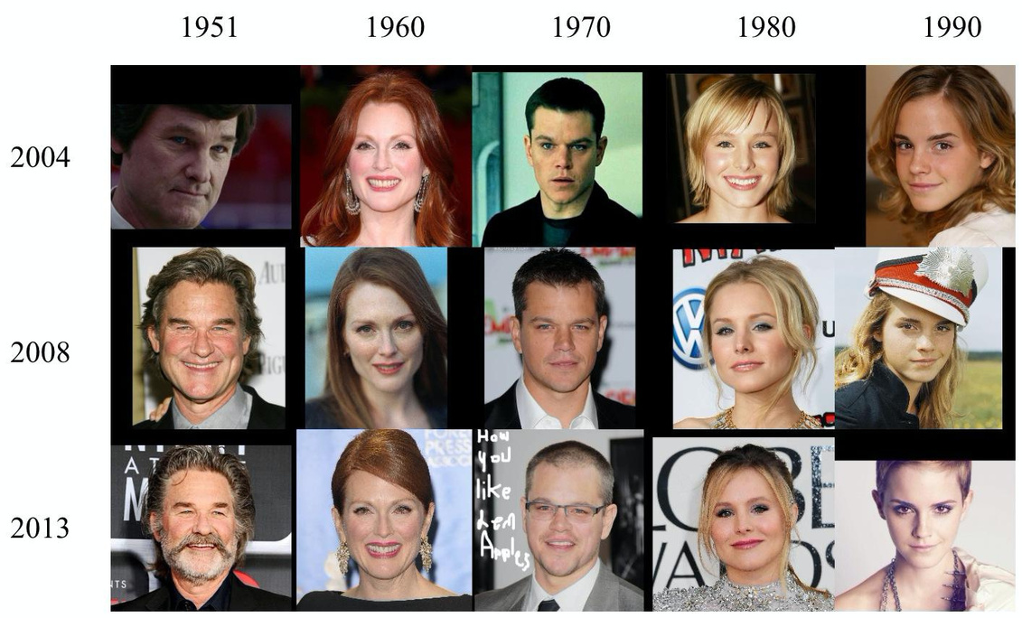
Dataset overview
03
CACD
FGNet

Slide 9
FGNet
03
82 people, 1002 images
Has a relatively small number of images, it covers a wide range of ages
The average number of images per individual is 12
Half of images were under the age of 13
50
40
30
20
10
0
0
2
4
6
8
10
12
14
16
18
20
22
24
26
28
30
32
34
36
38
40
42
44
46
48
50
52
54

Slide 10
CACD
03
163,446 images from 2,000 celebrities
The age of the subjects was 12 - 62 years old.
Have various lighting, expressions, and poses
5.000
4.000
3.000
2.000
1.000
0
14
16
18
20
22
24
26
28
30
32
34
36
38
40
42
44
46
48
50
52
54
56
58
60
62

Slide 11
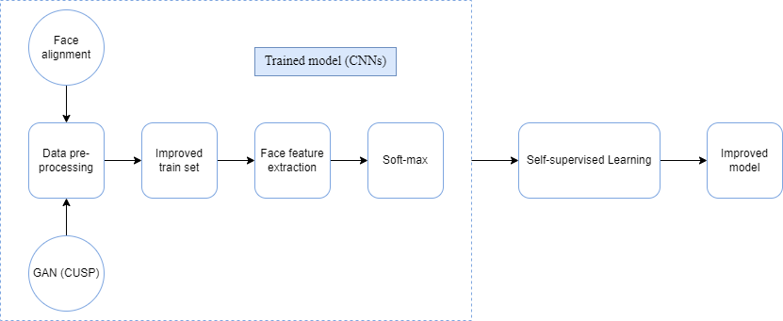
03
Workflow

Slide 12
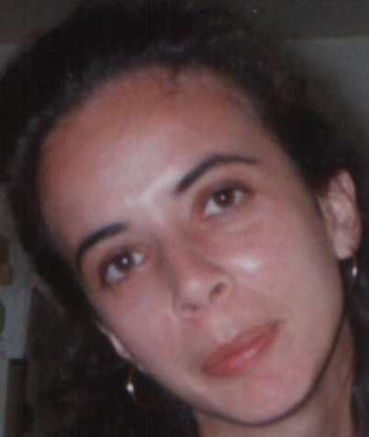
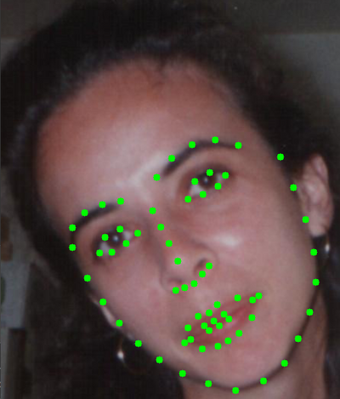
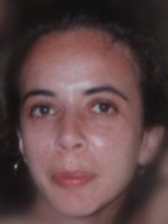
Facial landmark detection and alignment
03
Landmarks
Alignment
detection
Using DLib 68-point facial landmark detector
Using 68 coordinate points to mark important facial landmarks such as eyebrows, eyes, nose, mouth and chin

Slide 13
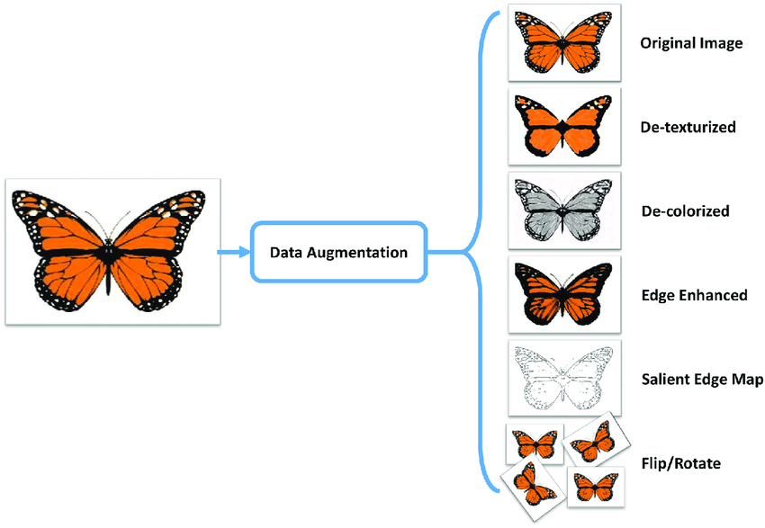
03
Data Augmentation
A technique of artificially increasing the training set by creating modified copies of a dataset using existing data.
It includes making minor changes to the dataset or using deep learning to generate new data points.

Slide 14
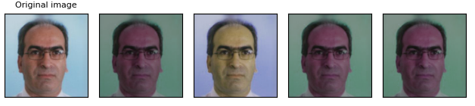
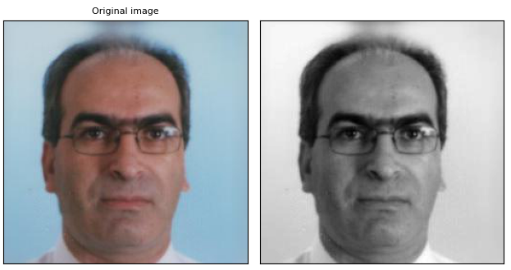
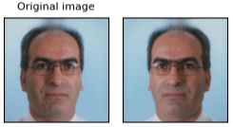
03
Data Augmentation techniques
Color
Jitter
Gray Scale
Horizontal Flip

Slide 15
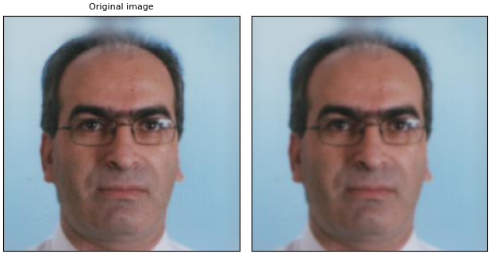
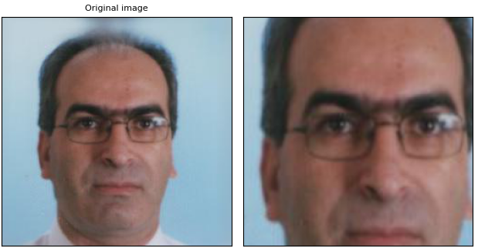
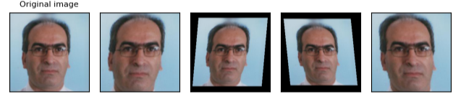
03
Data Augmentation techniques
Gaussian Blur
Random Resized Crop
Random
Affine

Slide 16
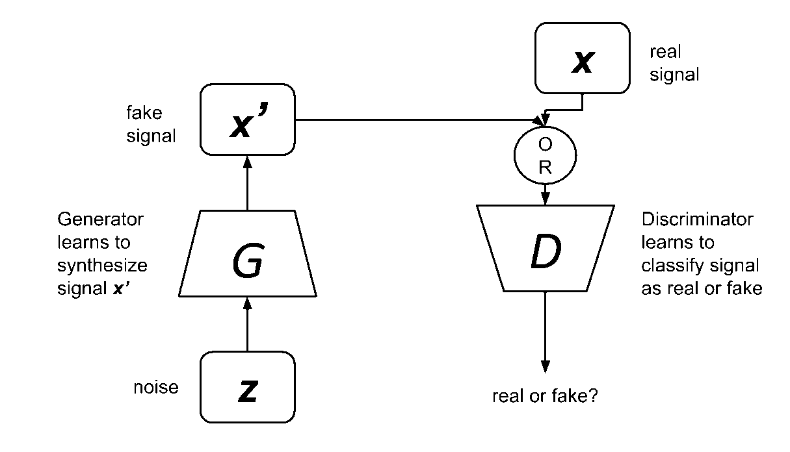
Face age editing using
Generative Adversarial Network
03
Two networks: a generator and discriminator.
The discriminator is trained to distinguish between real and fake signals or data.
The generator learns to generate fake signals or data that can eventually fool the discriminator.

Slide 17
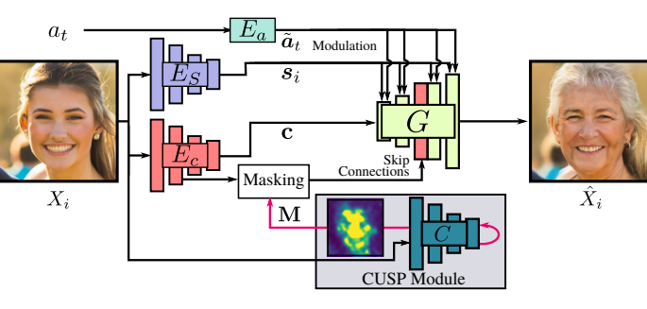
Custom Structure Preservation in Face Aging (CUSP)
03
Model architecture
Style Encoder Network Es
Content Encoder Ec
Age Encoder Ea
CUSP module
Generator Network G

Slide 18
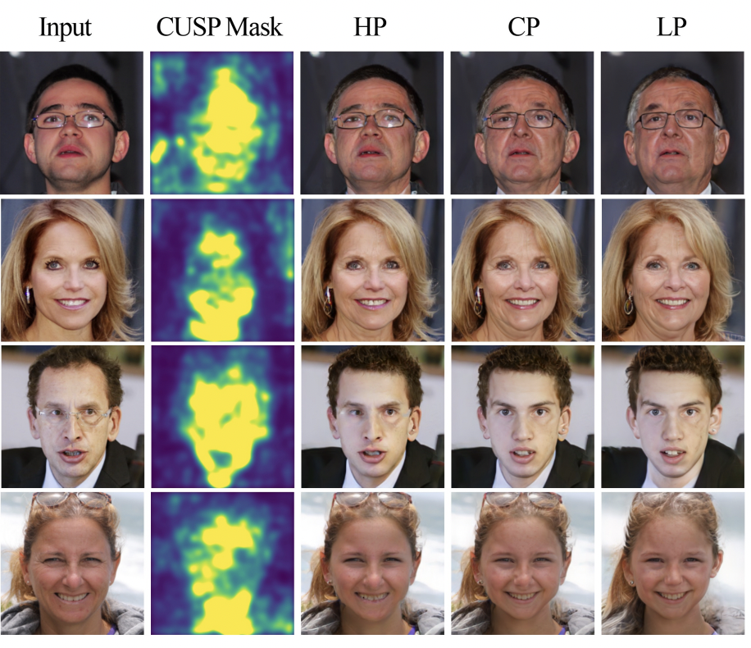
03
Impact of the kernel value: images obtained with High, Custom, and Low structure preservation (HP, CP, and LP).
HP:(σₘ, σg) = (0, 0); CP:(σₘ, σg) = (9, 0); LP:(σₘ, σg) = (9, 9).
The second column shows the mask estimated by CUSP

Slide 19
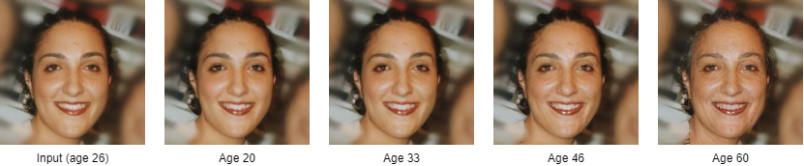
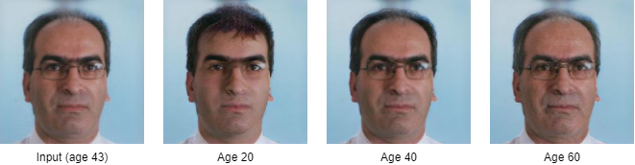
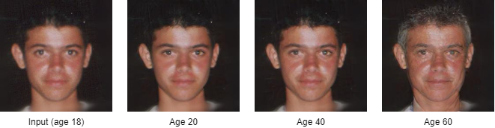
03
Using CUSP on FGNet dataset

Slide 20
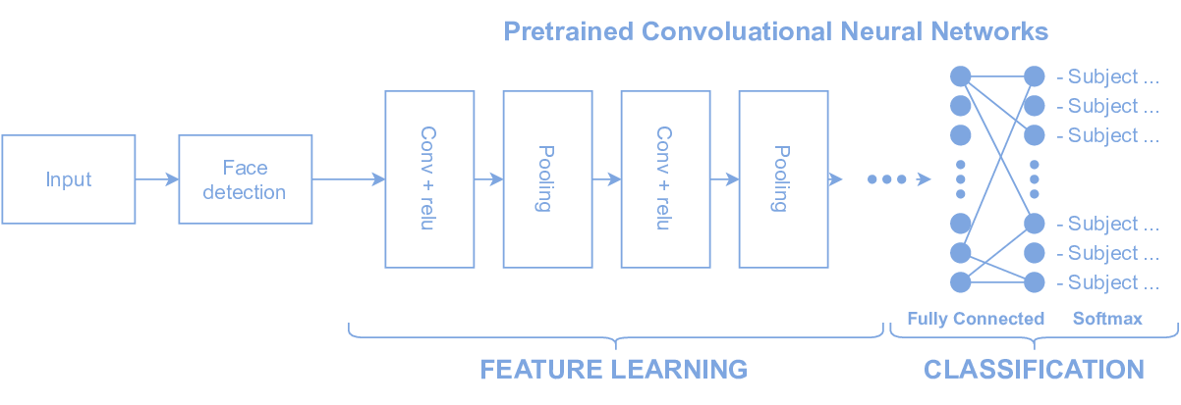
03
Age-Invariant Face recognition models

Slide 21
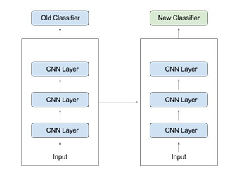
03
Transfer Learning
Pre-trained model
Source Tasks and Target Tasks
Transfer Learning

Slide 22
03
Pre-trained models
ResNet-18 for FGNet and ResNet-50 for CACD
Using Pytorch framework
Using Model Checkpoint with the purpose that after each EPOCH will save the best MODEL
Using the Early_Stopping function to stop the model training when the process begins to overfitting or underfitting

Slide 23
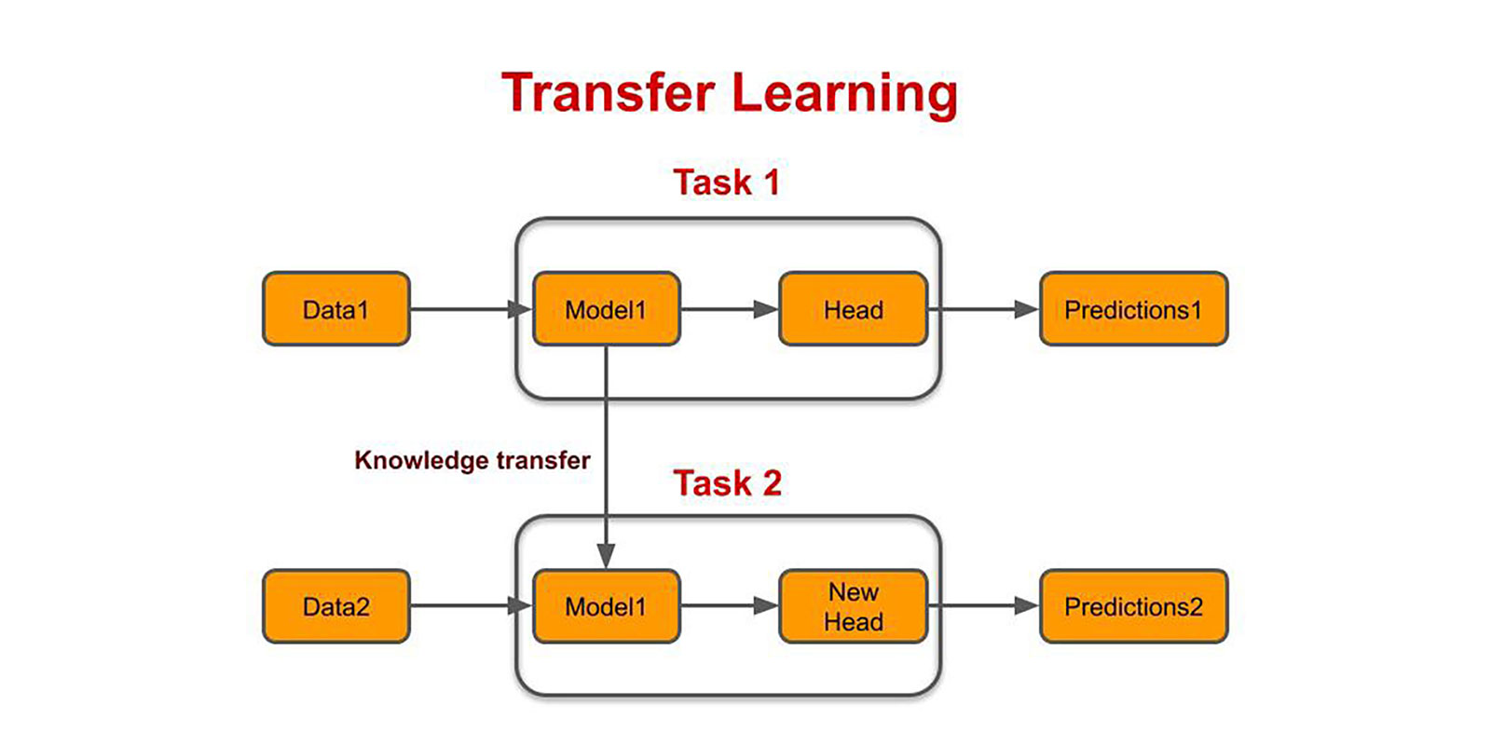
Source Tasks and Target Tasks
03

Slide 24
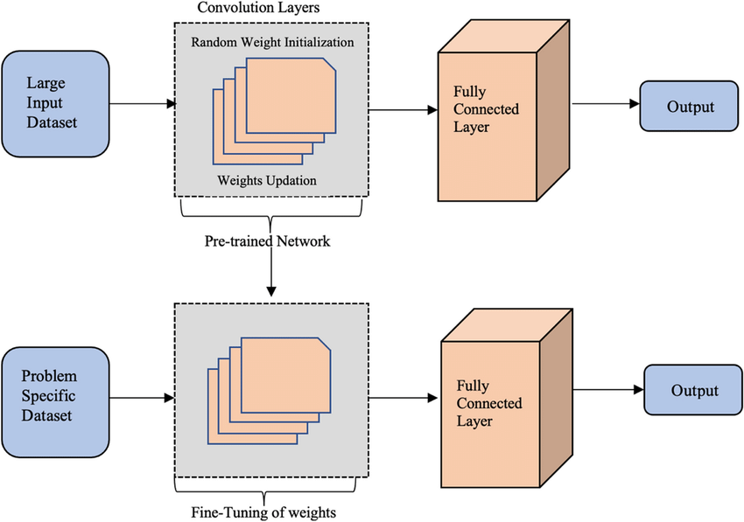
03
Transfer Learning

Slide 25
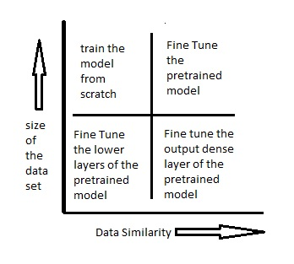
03
Transfer Learning
Add layers that match our target tasks, remove pretrained model layers that we don't use
·Having a good training strategy

Slide 26
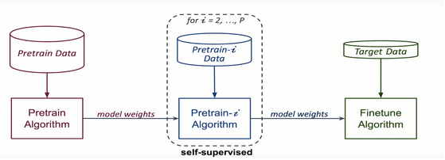
03
Self-Supervised Learning

Slide 27
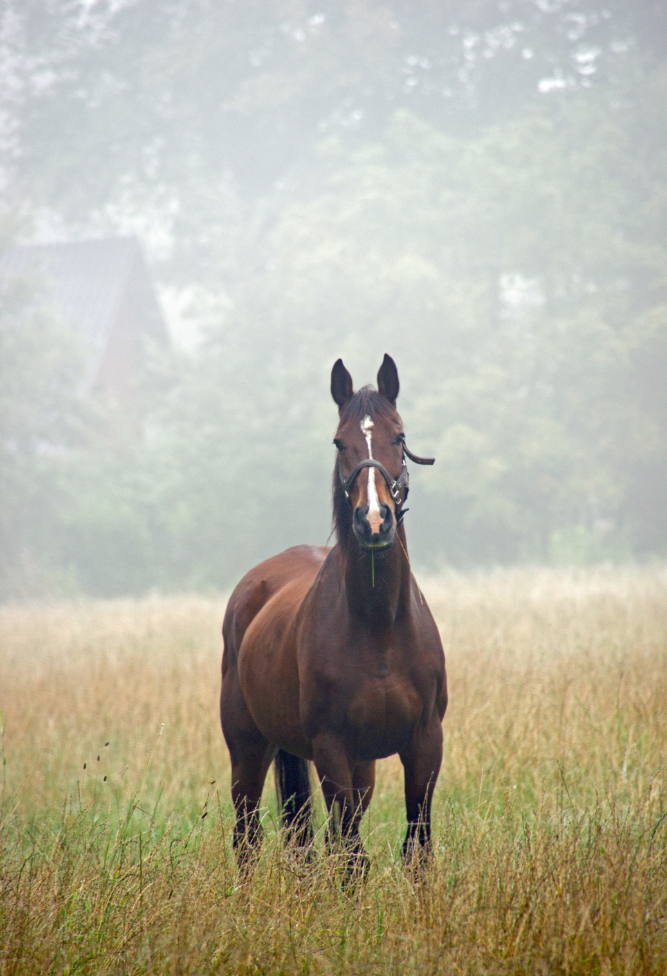
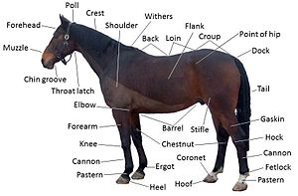
03
Self-Supervised Learning

Slide 28
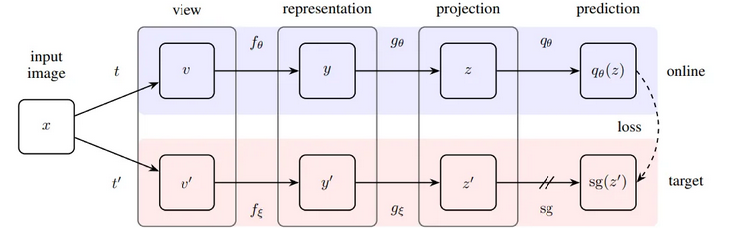
Bootstrap Your Own Latent (BYOL)
03
Interaction between two neural networks, namely the online and target networks, to learn from each other.
The technique involves training the online network to predict the target network’s representation of an image

Slide 29
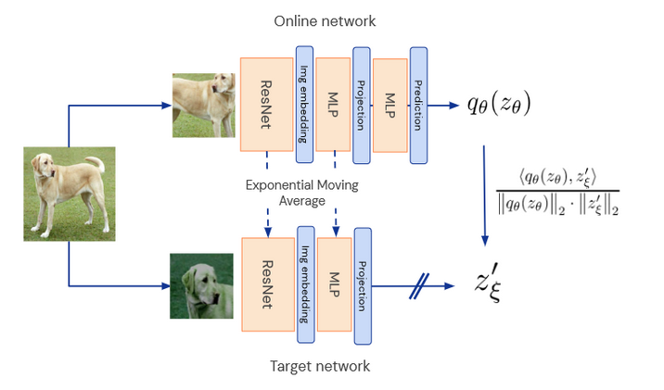
03

Slide 30
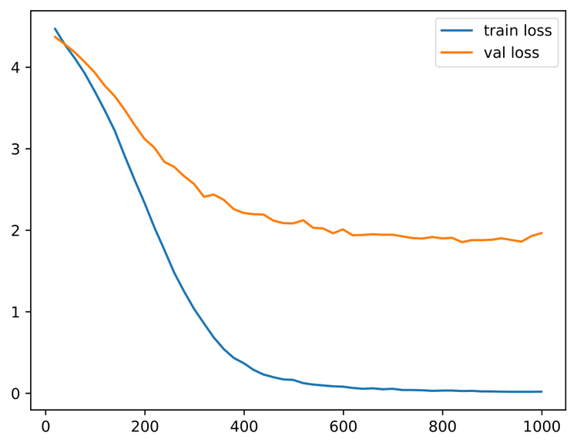
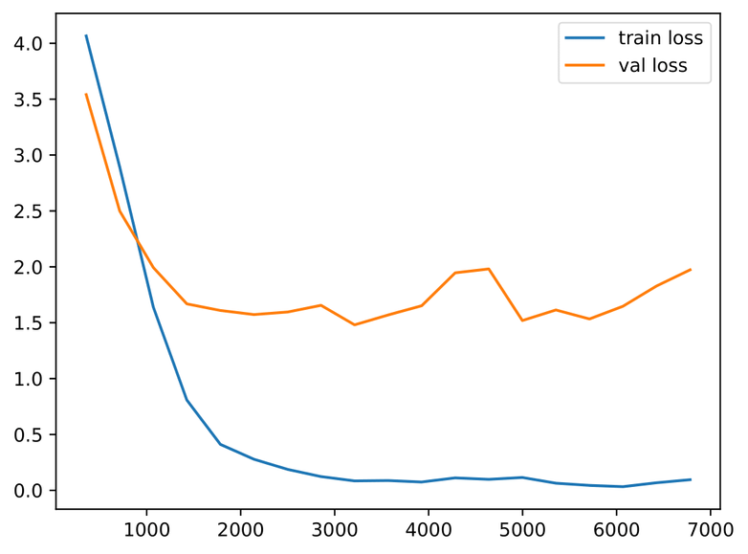
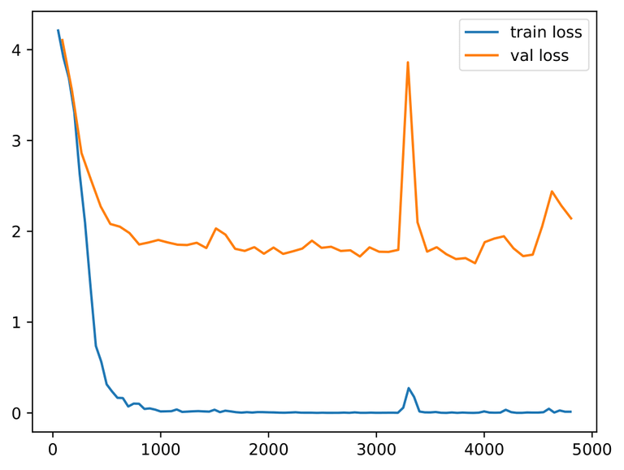
On FGNet dataset
04
Baseline loss on FGNET
Loss after using GAN on FGNET
Loss after using self-supervised learning on FGNET

Slide 31
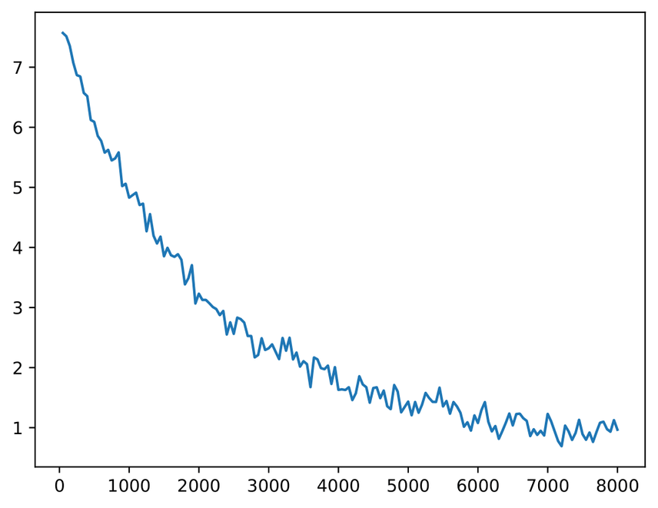
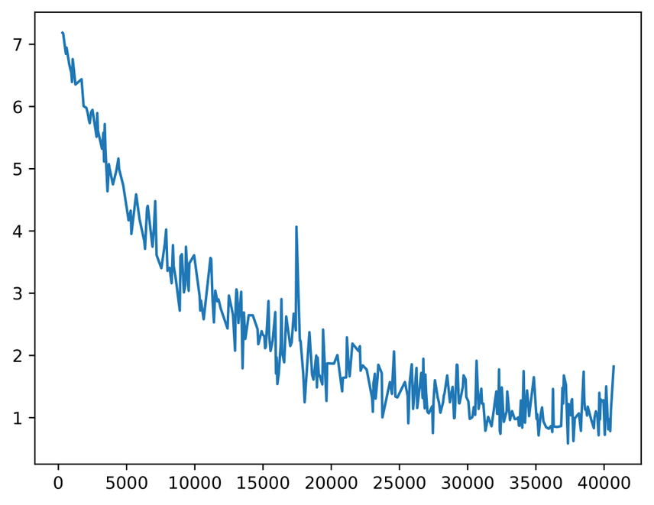
On CACD dataset
04
Baseline loss of train set
Loss of train set after using SLL

Slide 32
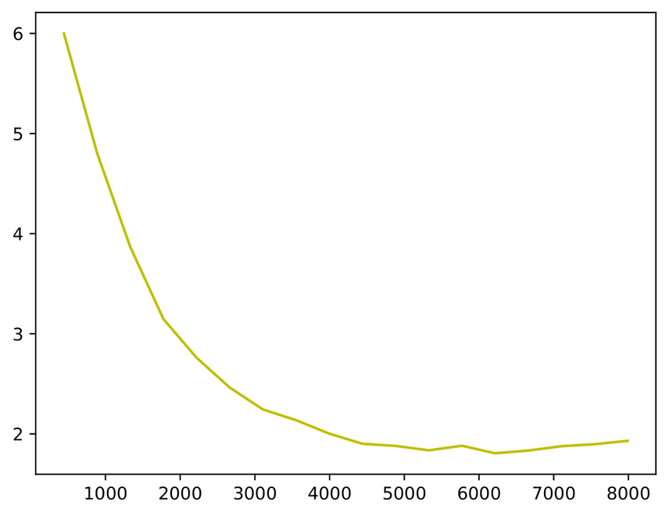
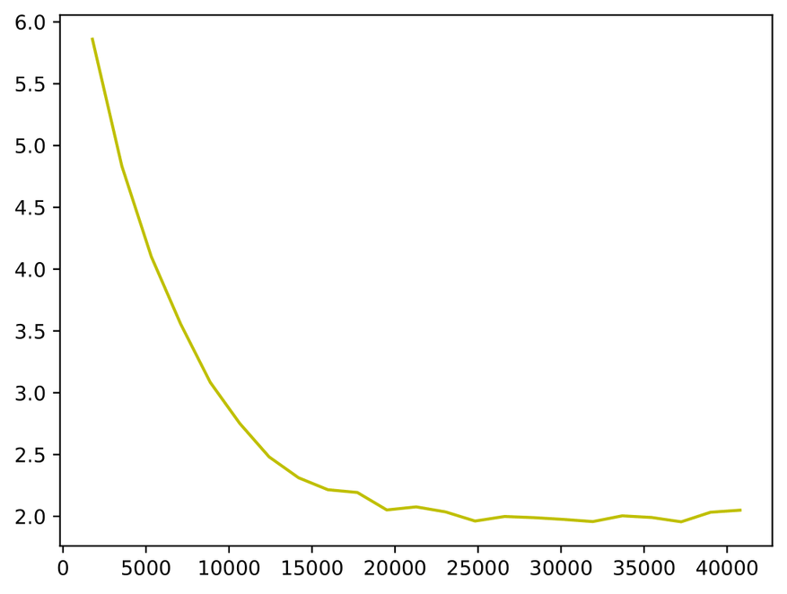
On CACD dataset
04
Baseline loss of validation set
Loss of validation after using Self-Supervised Learning

Slide 33
Result
04
Test - FGNet
Val - FGNet
Test - CACD
Val - CACD
80
77.2
77.9
75.7
76.7
75.3
69.1
64.1
60
59.3
57.9
51.3
40
20
0
Baseline
GAN
BYOL

Slide 34
04
DEMOSTRATION

Slide 35

05
Conclusion
Accuracy increase of 8% on the test set and 6.2% on the validation set
Submitted a research paper to The 2nd International Conference on Intelligence of Things (ICIT2023)

Slide 36
Thank You

